Slide 1
Cornell University Uses Integer Programming to Optimize Final Exam Scheduling
INFORMS Undergraduate Operations Research Prize Finalist Session
October 15th, 2023
Tinghan (Joe) Ye ^{1,2} Willem van Osselaer ^{1,3}
Qihan (Jody) Zhu ^{1,4} David Shmoys ¹
¹ Cornell ORIE ² Georgia Tech ISyE ³ Optimal Solutions Inc. ⁴ CMU Tepper

Slide 2
Acknowledgements & Thanks
Past and current members of the Cornell ORIE scheduling team:
Jian Kai Ang, Ja Young Byun, Kaylin Chan, Bennett Van Dellen, Rithvik Duggireddy, Caroline He, Samiksha Hiranandani, Jessie Jia, Daniel Jin, Adam Jovine, Wendy Liang, Joanna Lin, Jolene Mei, Bennett Miller, Eva Zhang & more
&
Shijin Rajakrishnan, Oktay Gunluk, & more from Cornell
&
Casey Washburn … from the Cornell University Registrar

Slide 3
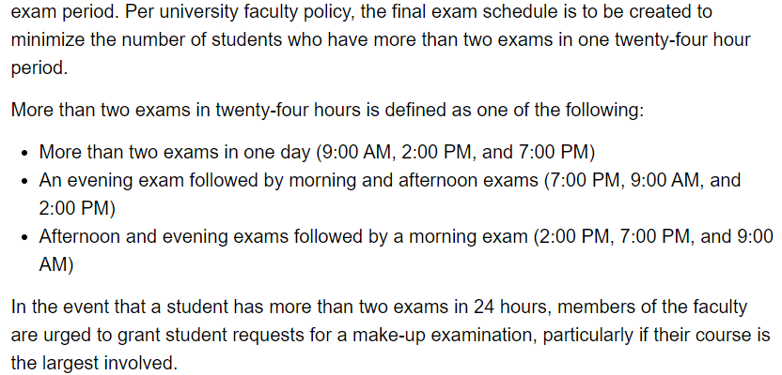
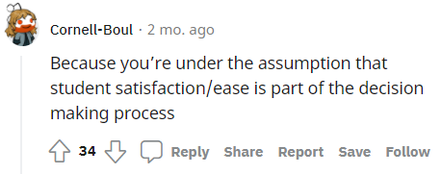
Background

Slide 4
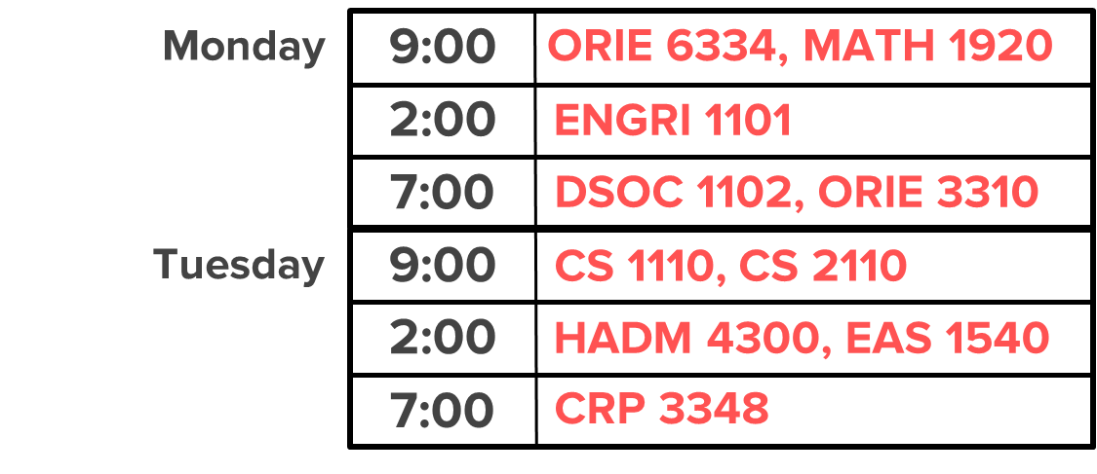
What does a final schedule look like?
7 to 9 exam days
3 time slots per day
9 AM, 2 PM, 7 PM
19 to 22 available time slots
More than 500 exams
Monday
9:00
ORIE 6334, MATH 1920
2:00
ENGRI 1101
7:00
DSOC 1102, ORIE 3310
Tuesday
9:00
CS 1110, CS 2110
2:00
HADM 4300, EAS 1540
7:00
CRP 3348

Slide 5
What determines a good schedule?
Conflicts
Back-to-backs
Triples
3 in 4 slots
Monday
9:00
ORIE 6334, MATH 1920
Monday
9:00
ORIE 6334, MATH 1920
Monday
9:00
ORIE 6334, MATH 1920
Monday
2:00
ORIE 6334, MATH 1920
Monday
9:00
ENGRI 1101
2:00
ORIE 6334, MATH 1920
9:00
ENGRI 1101
2:00
ENGRI 1101
7:00
DSOC 1102, ORIE 3310
2:00
ENGRI 1101
7:00
DSOC 1102, ORIE 3310
2:00
ENGRI 1101
Tuesday
7:00
DSOC 1102, ORIE 3310
9:00
DSOC 1102, ORIE 3310
Tuesday
7:00
CS 1110, CS 2110
9:00
DSOC 1102, ORIE 3310
Tuesday
7:00
CS 1110, CS 2110
Tuesday
9:00
CS 1110, CS 2110
2:00
HADM 4300, EAS 1540
Tuesday
9:00
CS 1110, CS 2110
9:00
CS 1110, CS 2110
2:00
CRP 3348
7:00
HADM 4300, EAS 1540
2:00
CRP 3348
7:00
HADM 4300, EAS 1540
7:00
CRP 3348
7:00
CRP 3348
7:00
CRP 3348
Student 1
Student 2
Student 3
Monday
Monday
Monday
Exam
Exam 1
Exam
Exam
Exam 2
Exam
Exam
Tuesday
Tuesday
Tuesday
Exam
Exam 1
Exam
Exam
Exam 2
Wednesday
Wednesday
Exam
Wednesday
Exam

Slide 6
Scheduling Optimization Framework

Slide 7
Base Model – Block Assignment
EAS 1540
5
ENGRI 1101
7
1
8
5
18
3
HIST 1561
MATH
1920
2
4
CRP 3348
1
ORIE 6334
Represent the exam data in a graph

Slide 8
Base Model – Block Assignment
Conflicts: 6
5
7
1
8
5
18
3
2
4
1

Slide 9
Base Model – Block Assignment
Conflicts: 6 4 6
5
7
1
8
5
18
3
2
4
1

Slide 10
Base Model – Block Assignment
K-coloring Problem!
Conflicts: 6 4 0 6
5
7
1
8
5
18
3
2
4
1

Slide 11
Base Model – Block Assignment
Greedy Coloring
Quick but no guaranteed number of blocks
Integer Programming

Slide 12
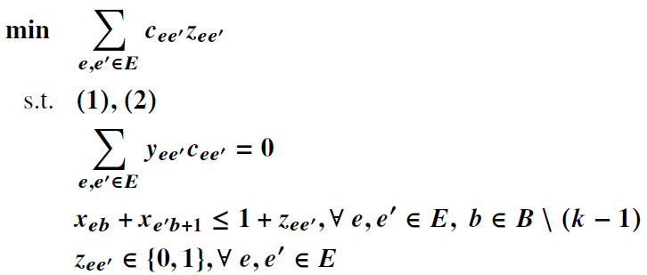
Base Model – Block Assignment
Assign each exam $e∈E$ to one of the $k$ blocks.
Exams in the same block will be later scheduled at the same time.
Minimize inner-block pairwise conflicts
Zero inner-block pairwise conflicts
(1)
(2)

Slide 13
Base Model – Block Sequencing
Order
5
7
1
B2Bs = 36
8
5
18
3
2
4
1

Slide 14
Base Model – Block Sequencing
Order
5
7
1
B2Bs = 36 21
8
5
18
3
2
4
1

Slide 15
Base Model – Block Sequencing
The four-index variables: $x_{ijls}$
i.e., if ${ x}_{ijls}=1$, then ${ x}_{jlm\left(s+1\right) mod k}=1$ for some block m
Cyclic self-consistence

Slide 16
Base Model – Block Sequencing
Minimize weighted sum of back-to-backs, triples, three in four slots

Slide 17
Base Model – Block Sequencing
Front-loading large exams
“Virtual blocks” – optimizing slot configuration

Slide 18
Issue with the 2-stage model
1. Block assignment
2. Sequencing
1
1 conflict
1
7
1
3
4 B2Bs
1
1
7
3
1
1
1 conflict
1
7
2 B2Bs
3
1

Slide 19
Base Model – Post-processing
2
2
Fix order
1
5
1
REPEAT
3
5
3
1
1
1 conflict
8 B2Bs
1 conflict
4 B2Bs

Slide 20
Layer-cake Heuristic Algorithm

Slide 21
Results & Impact
Successfully adopted by the Cornell University Registrar for 3 consecutive semesters (and more) since Spring 2022 !

Slide 22
Experiments

Slide 23
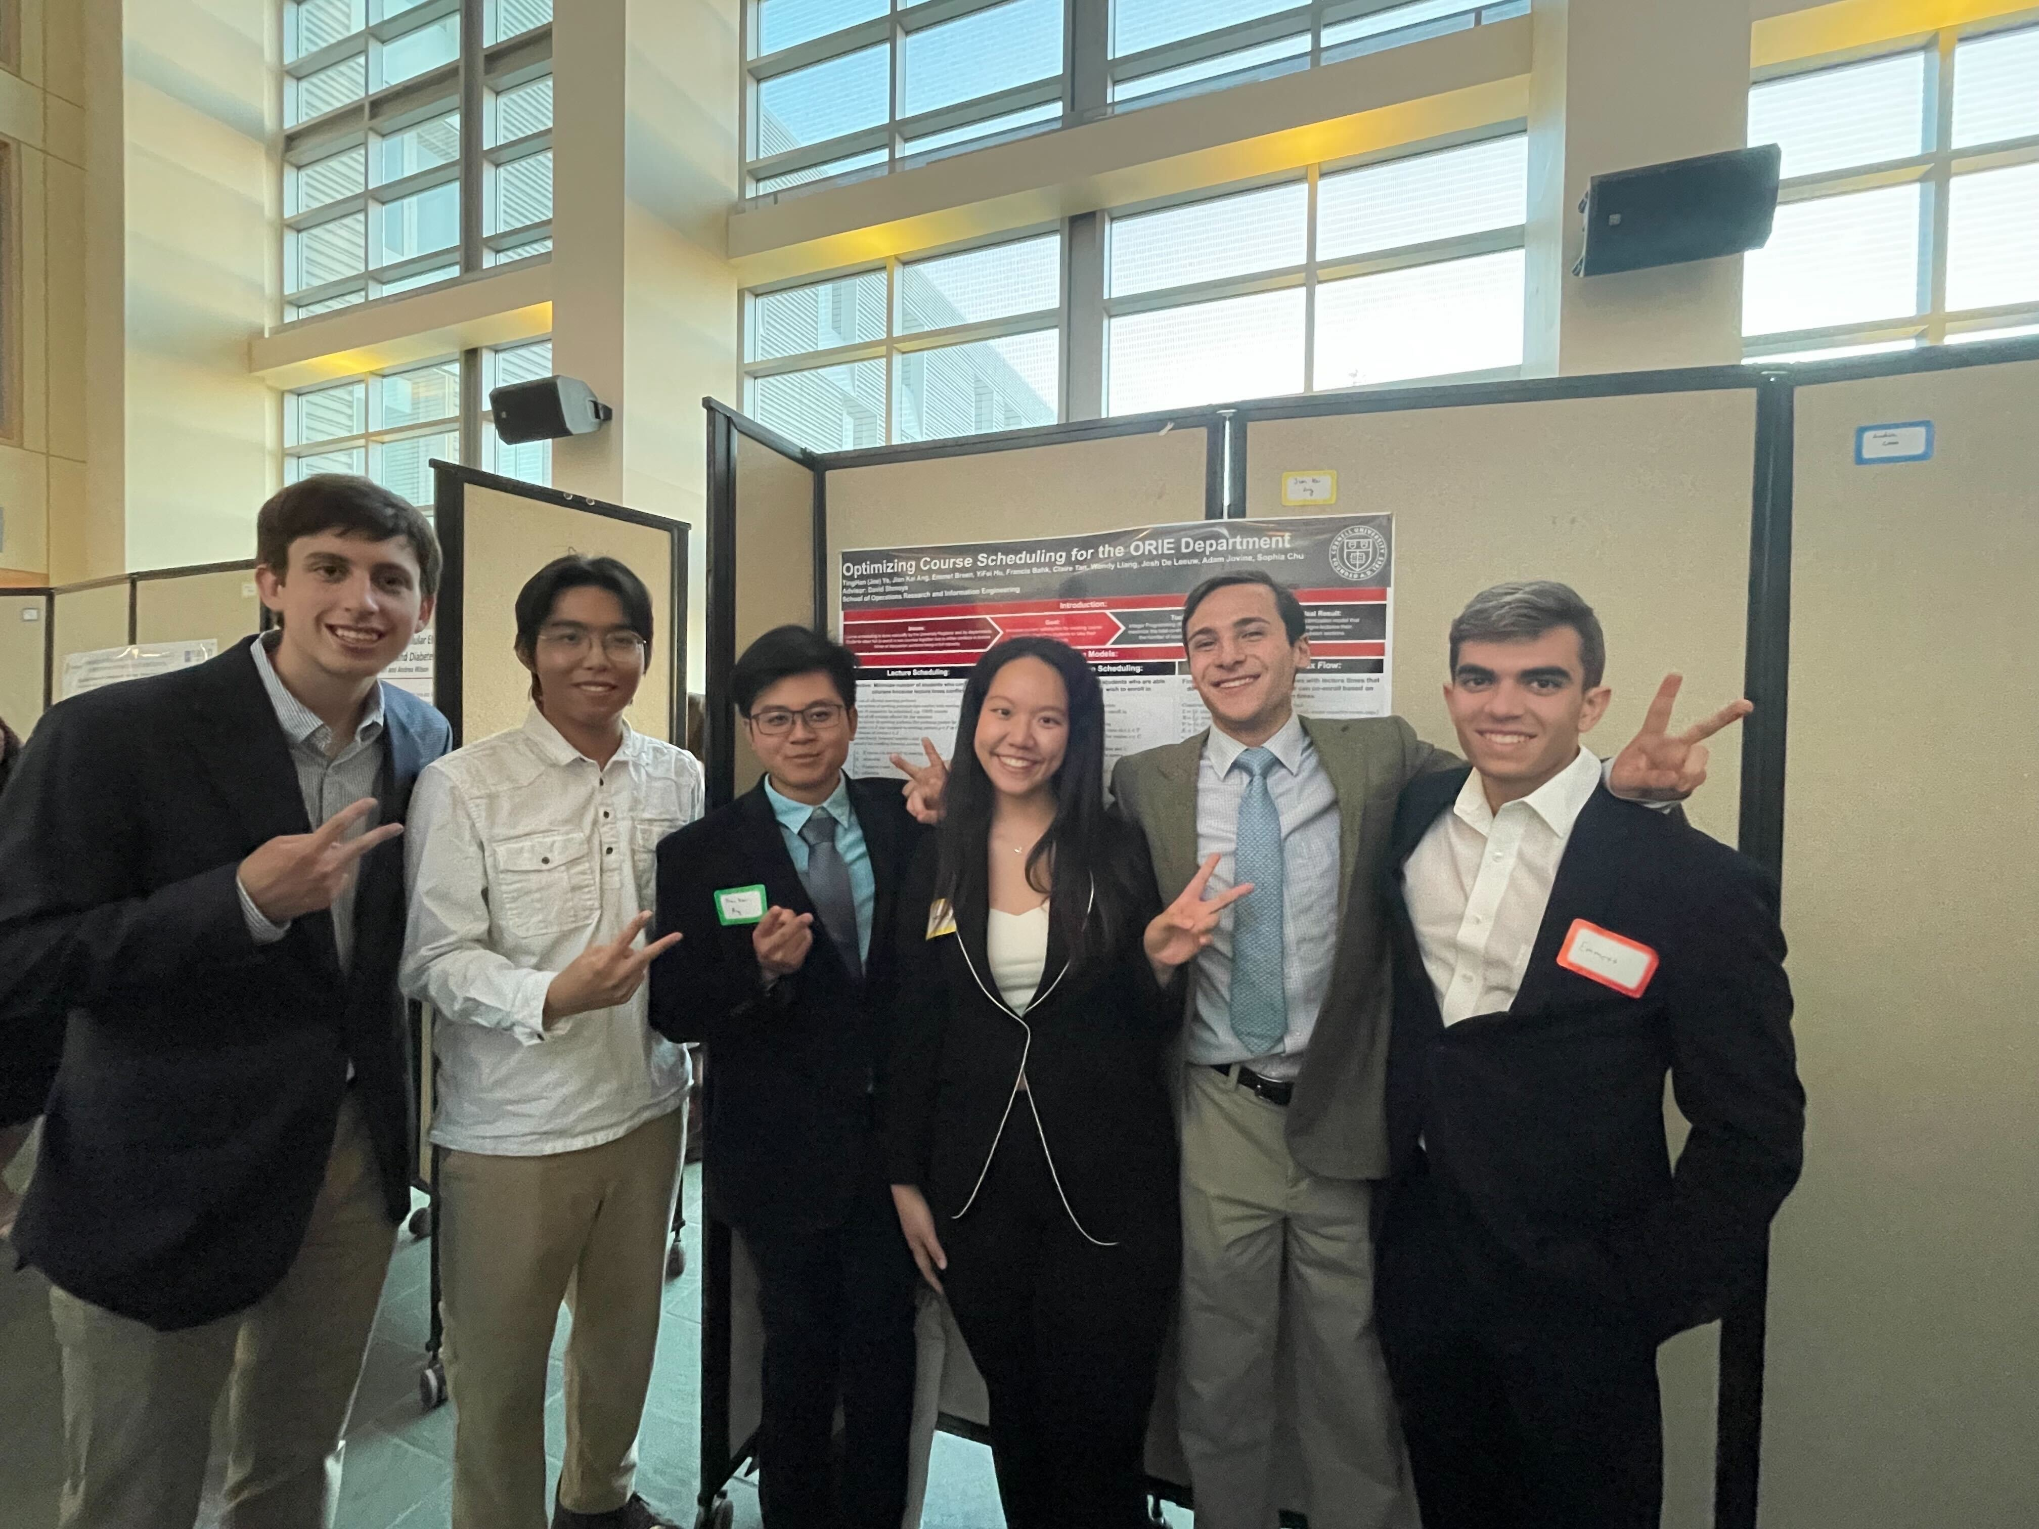
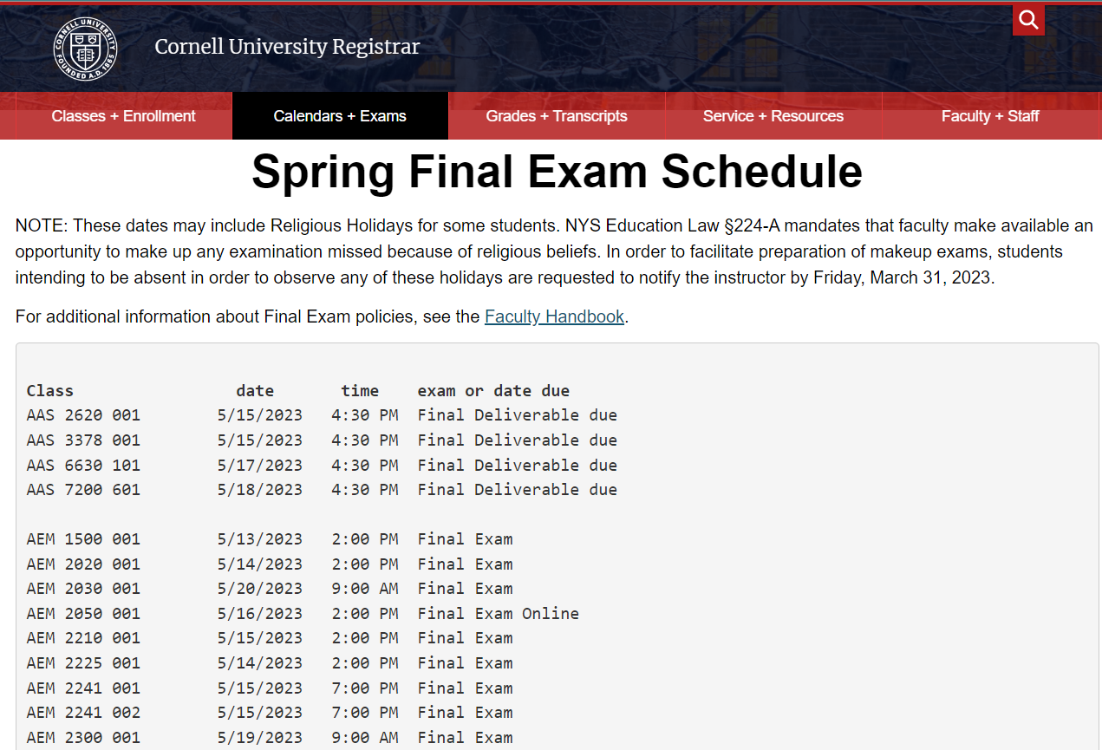
Implementation
=> Gather the scheduling team
=> perform experiments
=> display schedules to the Registrar
=> published!

Slide 24
Work-in-progress
Enrollment prediction for earlier scheduling
Current schedule takes one month after the semester begins to be released
Use historical and pre-enrollment data to predict post-Add/Drop enrollment

